Slide 1
Science of Living System
BS20001 (2-0-0)
Genetic Engineering
Ritobrata Goswami
School of Bioscience
Email: ritobrata.goswami@iitkgp.ac.in
Tel: 03222-260518

Slide 2
Lecture | Date | Topic
1 | 03/01/2018 | Nucleic acids – 1
2 | 10/01/2018 | Nucleic acids – 2
3 | 17/01/2018 | Transcription and Translation – 1
4 | 24/01/2018 | Transcription and Translation – 2
5 | 31/01/2018 | Protein structure – 1
6 | 07/02/2018 | Protein structure – 2 / Discussion and Revision
** | 14/02/2018 | CLASS TEST - 1
7 | 28/02/2018 | Enzymes
8 | 07/03/2018 | Cellular architecture
9 | 14/03/2018 | Cell division and apoptosis
10 | 21/03/2018 | Host defense/vaccines
11 | 28/03/2018 | Genetic Engineering & its impact
** | 04/04/2018 | CLASS TEST - 2
** | 11/04/2018 | DISCUSSION AND REVISION

Slide 3
Genetic Engineering / Recombinant DNA Technology
Manipulation of an organism’s genome
Can range from changing one base pair (A-T or C-G), deleting a whole region of DNA, or introducing an additional copy of a gene
Extracting DNA from an organism’s genome and combining it with the DNA of another individual
Used for enhancing or modifying the characteristics of an individual organism

Slide 4
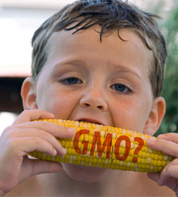
Applications of Genetic Engineering
Agricultural application (Bt Cotton, Genetically modified sweet corn etc.)
Application in Dairy, Poultry Farms etc (Growth hormones in cow milk)
Environmental application (Pseudomonas putida, an oil eating bacteria)
Therapeutic application (Human insulin, many growth hormones, etc)

Slide 5
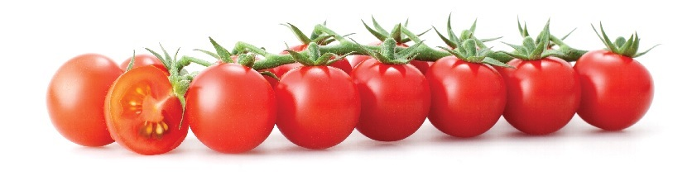
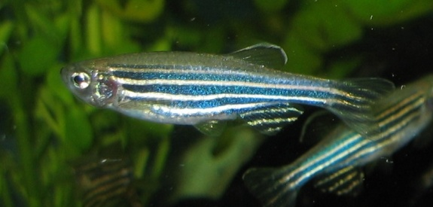
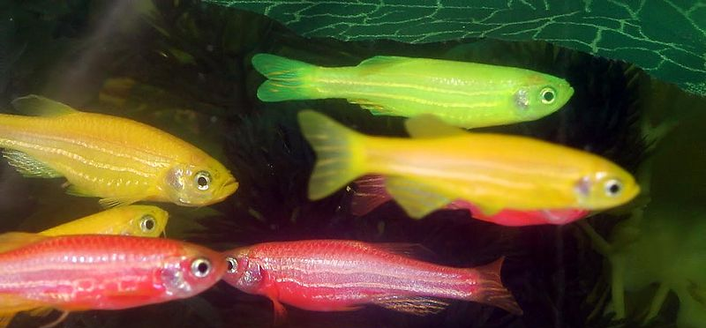
Genetically modified Product
Flavr Savr (also known as CGN-89564-2; pronounced "flavor saver"), a genetically modified tomato
Glow Fish: Zebra fish with green fluorescent protein (GFP) and others
Wild type zebra fish
Glow fish (genetically modified fish)

Slide 6
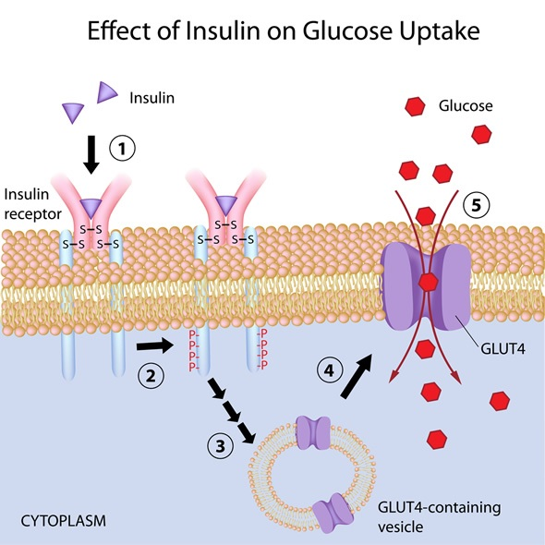

Slide 7
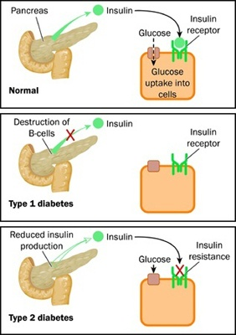
Insulin: an indispensable hormone in our body
Hormone that regulates the amount of glucose (sugar) in the blood and is required for the body to function normally
Insulin is produced by β-cells in the pancreas, in the islets of Langerhans
Insulin is constantly released in a small amount
Surge of insulin release in response to a rise in the blood glucose level (i.e., after meals)
Insulin allows transport of glucose from the blood into cells
Once transported into the cell, the blood glucose level is returned to normal within hours
Lack of insulin leads to reduced glucose uptake, causing high blood sugar level- Diabetes
(β-cells)
β-cells
endocrineweb.com
Notes:
Problems in the production or regulation of pancreatic hormones will cause complications related to blood sugar imbalance. Of all the diseases and disorders of the pancreas, the most well-known is diabetes.
Type 1 diabetes: Autoimmune disorder where insulin producing islets of Langerhans cells die. So, body doesn’t produce enough/any insulin to handle the glucose. People with type 1 diabetes have to take insulin to help their body use glucose appropriately.
Type 2 diabetes: much more prevalent. People with type 2 diabetes may be able to produce insulin, but their bodies don’t use it correctly (insulin resistance). They might also be unable to produce enough insulin to handle the glucose in their body. Lifestyle choices, such as diet and exercise, play a major role in managing and preventing type 2 diabetes.

Slide 8
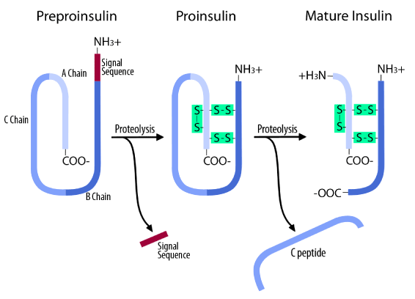
Production of Human Insulin: An example of Genetic Engineering/Recombinant DNA Technology

Slide 9
Production of Insulin
1921: Frederick Banting and Charles Best successfully purified insulin from a dog's pancreas. Over the years scientists made continual improvements in producing insulin
In the 1980s, researchers used genetic engineering to manufacture human insulin
In 1982, the Eli Lilly Corporation produced a human insulin that became the first approved genetically engineered pharmaceutical product
At present, researchers could produce genetically engineered insulin in unlimited supplies without depending on animals
HOW??
Genetic Engineering

Slide 10
Key Words in Genetic Engineering
Gene of interest: DNA segment that is to be inserted/deleted
Plasmid: a small, circular, double-stranded DNA molecule that is distinct from a cell's chromosomal DNA
Vector: DNA molecule used as a vehicle to artificially carry foreign genetic material into another cell where it can be expressed
Transformation: Transfer of gene of interest in to a host cell (may be bacteria) where it can be maintained as well as expressed.
Clone: Organisms carrying identical genes

Slide 11
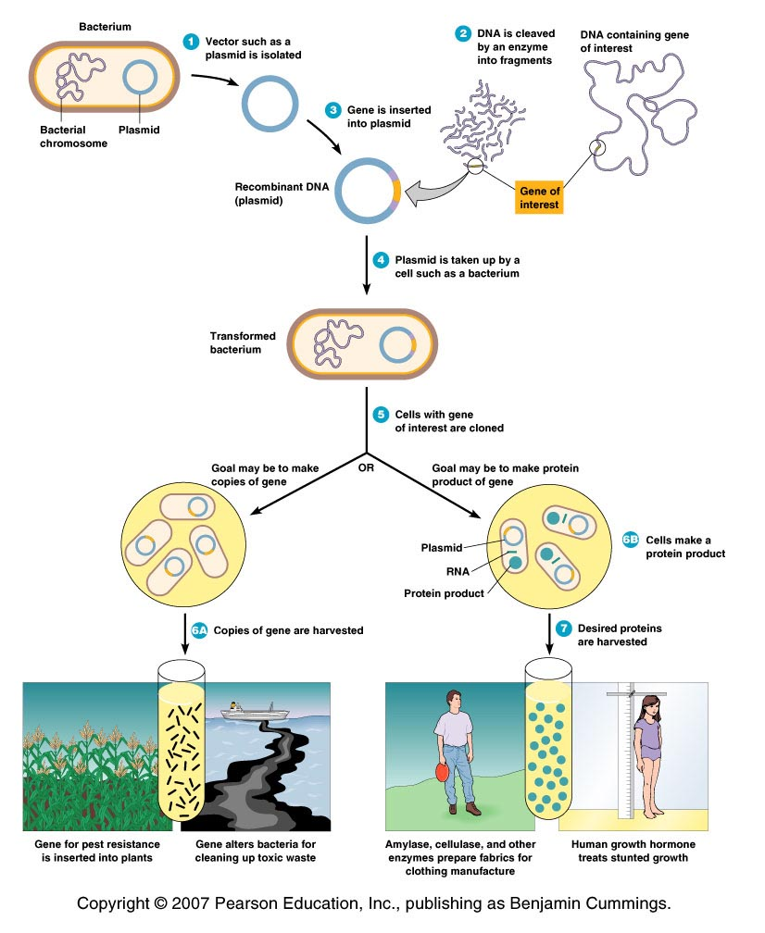
An Overview of Genetic Engineering
Gene of interest (DNA) is isolated
(DNA fragment)
This desired gene is inserted into a DNA molecule – vector
(plasmid, bacteriophage or a viral genome)
The vector inserts the DNA into a new cell, which is grown to form a clone.
(bacteria, yeast, plant or animal cell)
Large quantities of the gene product can be harvested from the clone

Slide 12
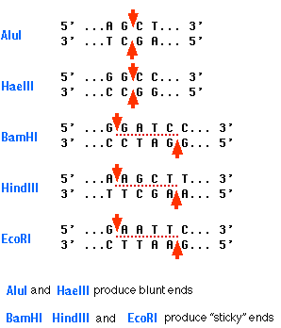

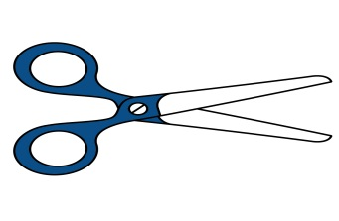

Tools for Genetic engineering 1. Restriction Enzymes
Naturally produced by bacteria – restriction endonucleases
Natural function - destroy bacteriophage DNA in bacterial cells
Cannot digest host DNA with methylated C (cytosine)
A restriction enzyme
Substrate –DNA -recognizes one particular nucleotide sequence in DNA and cuts the DNA molecule (breaks down the bond between two nucleotides)
Prepackaged kits are available for rDNA techniques
sticky ends
blunt ends

Slide 13
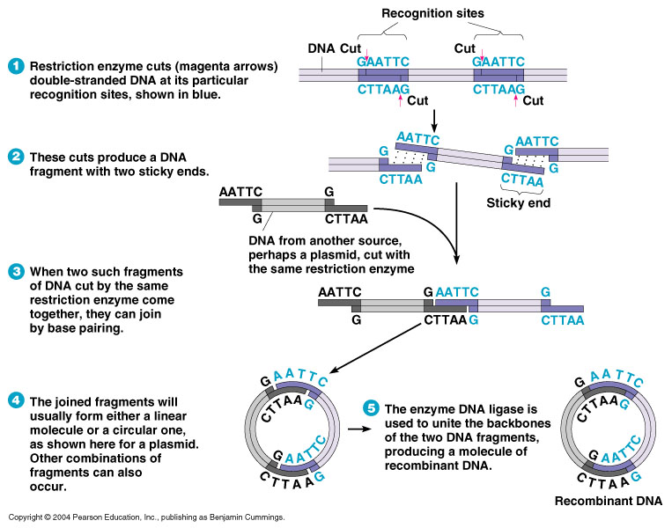
Restriction Enzymes: How it Works?
Fragments of DNA produced by the same restriction enzyme will spontaneously join by base pairing.
Each of the DNA strands will have a break

Slide 14
Frequency of occurrence of restriction sites
If DNA sequence has equal amounts of each base
If bases are distributed randomly
6 base cutter
(1/4)⁶ = 1 site in ~4000 bp
4 base cutter
(1/4)⁴ = 1 site in 256 bp

Slide 15
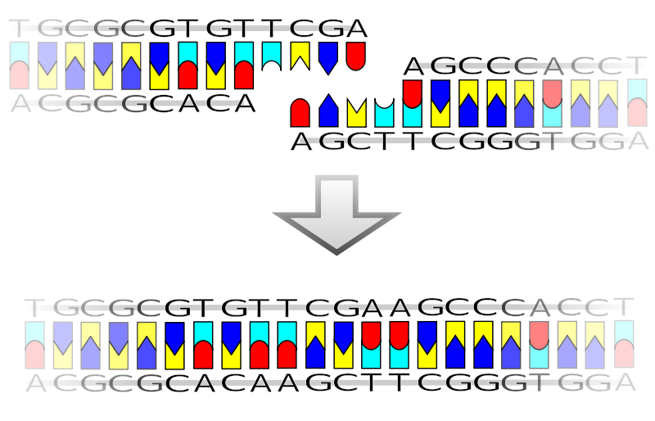

Tools for Genetic engineering 2. Ligase
DNA ligase is an enzyme that can link together DNA strands that have double-strand breaks (a break in both complementary strands of DNA).
Naturally DNA ligase has applications in both DNA replication and DNA repair .
Needs ATP
DNA ligase has extensive use in molecular biology laboratories for genetic recombination experiments
ATP

Slide 16
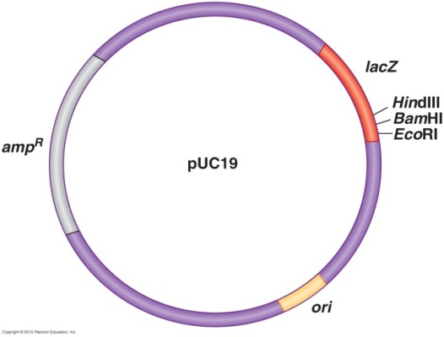
Tools for Genetic engineering 3. Plasmids
Vectors - Small pieces of circular DNA used for cloning
Requirements of the Vector
1. Self-replication - able to replicate in the host (independent origin of replication)
2. Cloning site -(region containing multiple restriction sites)
3. Promoter (and operator) - to support the expression of insert DNA (i.e. gene of interest) in the host.
4. Selectable marker – antibiotic resistance (Ampicillin resistant)
5. Proper size- for easy handling

Slide 17
Hosts for Recombinant DNA Technology
Bacteria
E. coli - used because is easily grown and its
genomics are well understood.
Gene product is purified from host cells
2. Yeasts - Saccharomyces cerevisiae
Used because it is easily grown and its genomics are known
May express eukaryotic genes easily
Continuously secrete the gene product.
Easily collected and purified
3. Plant cells and whole plants
May express eukaryotic genes easily
Plants are easily grown - produce plants with new properties.
4. Mammalian cells
May express eukaryotic genes easily
Harder to grow
Medical use.

Slide 18
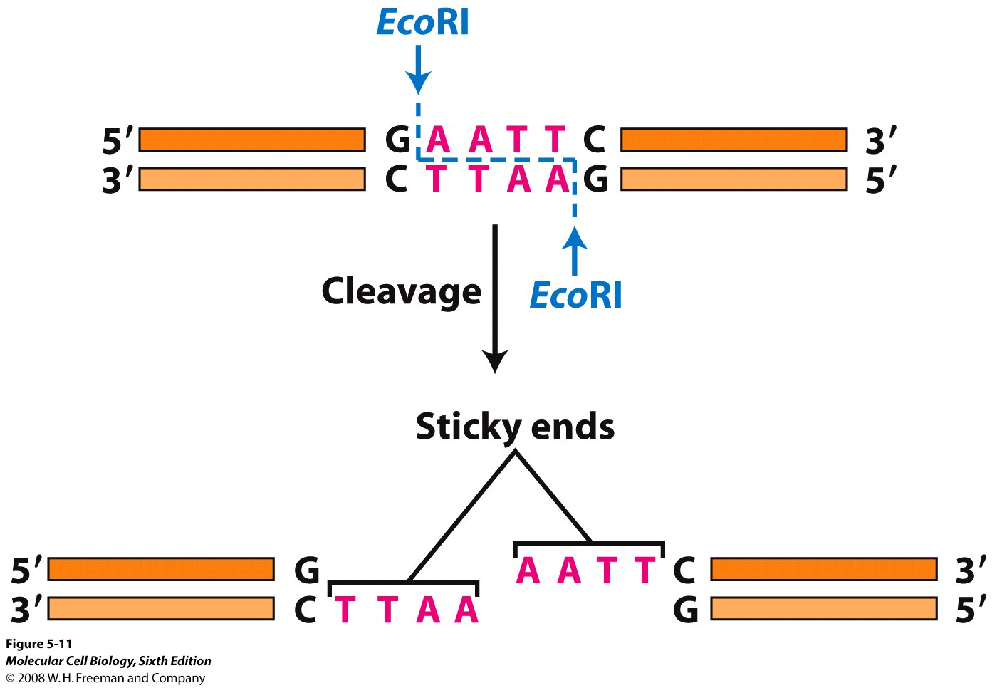
Cloning of a Gene

Slide 19
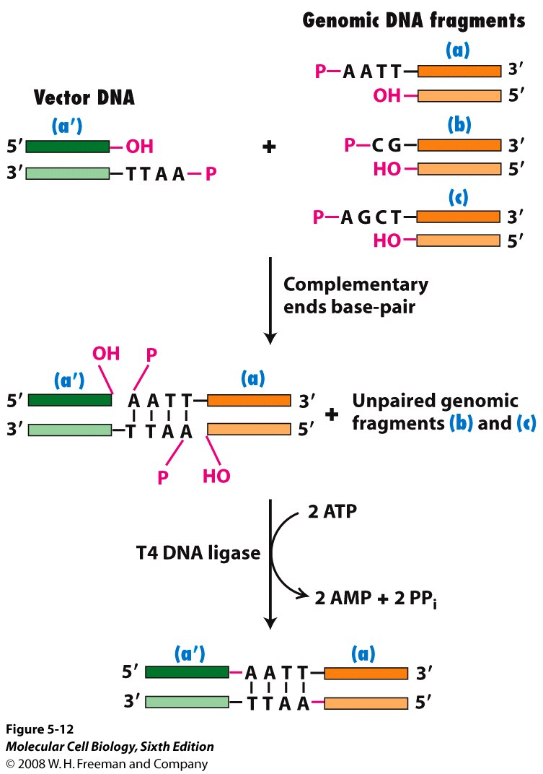
Cloning of a Gene

Slide 20
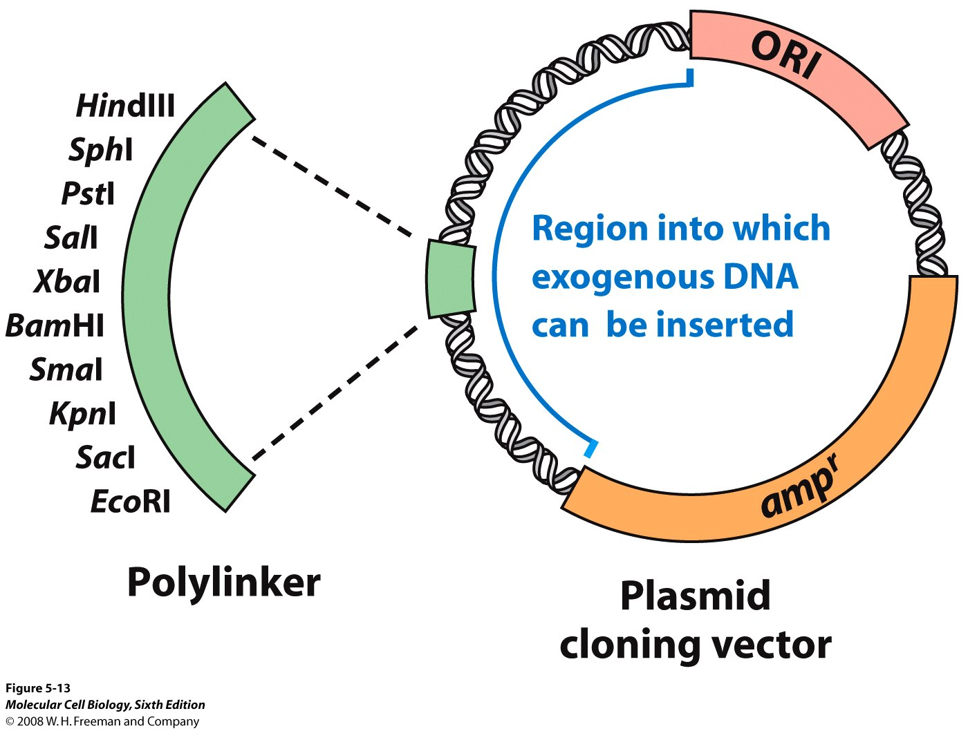
Cloning of a Gene

Slide 21
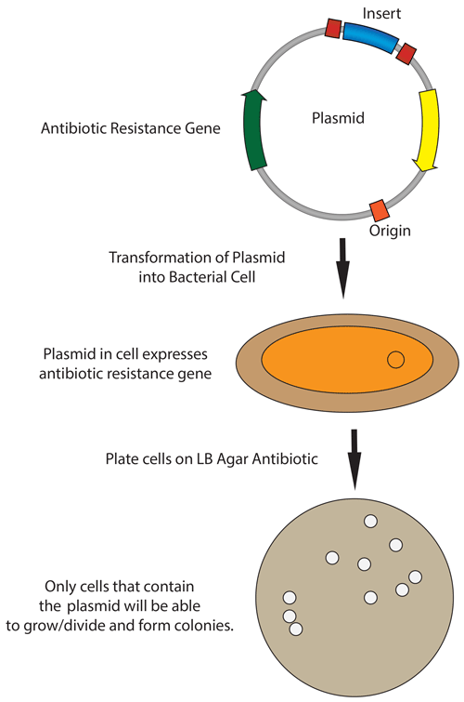
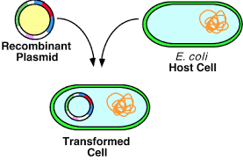

3. Transform recombinant DNA (vector + gene of interest) into a host:
Pick a colony of bacteria with recombinant vector
And culture to get more

Slide 22
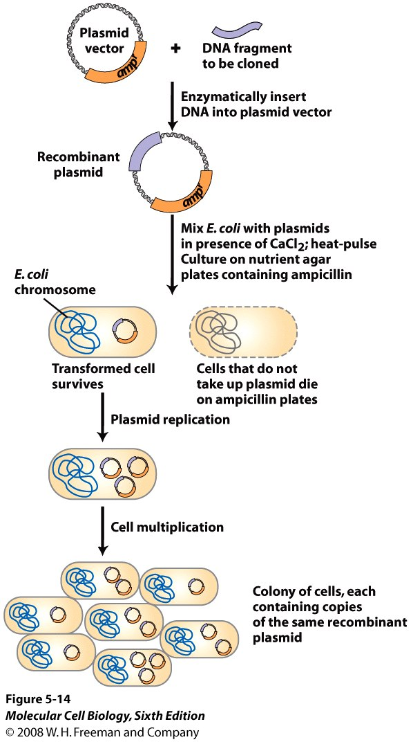
Cloning and Transformation of a Gene

Slide 23
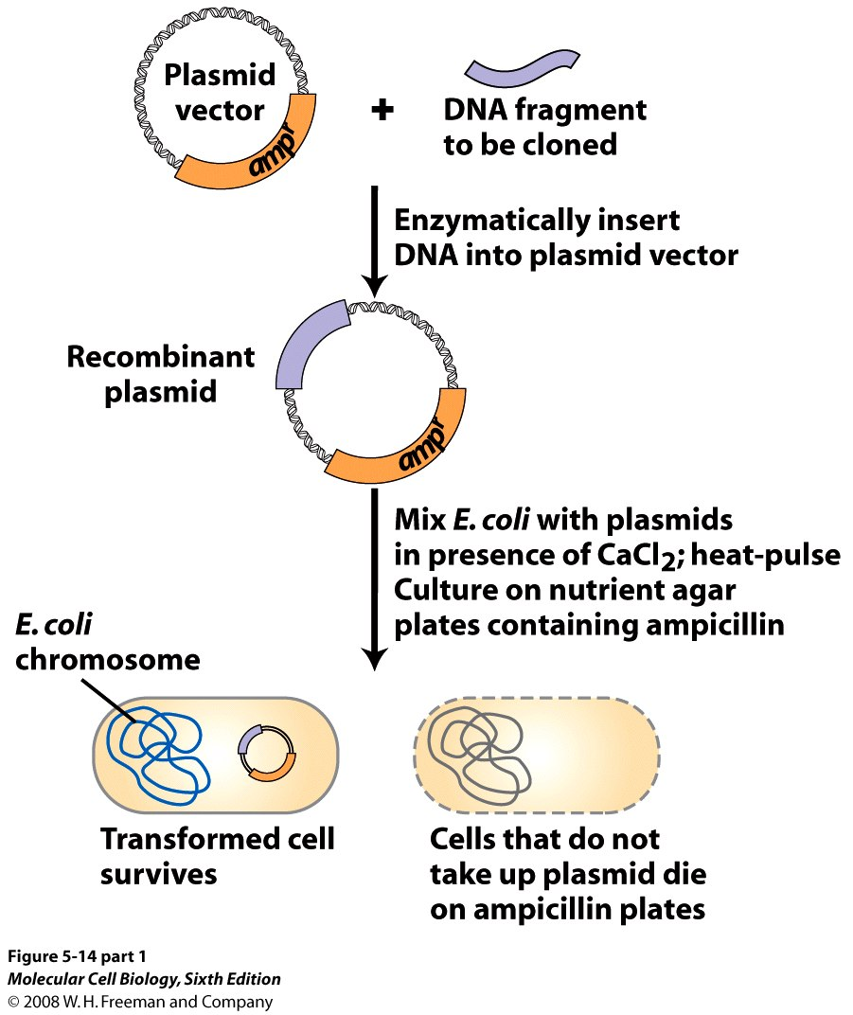
Cloning and Transformation of a Gene

Slide 24
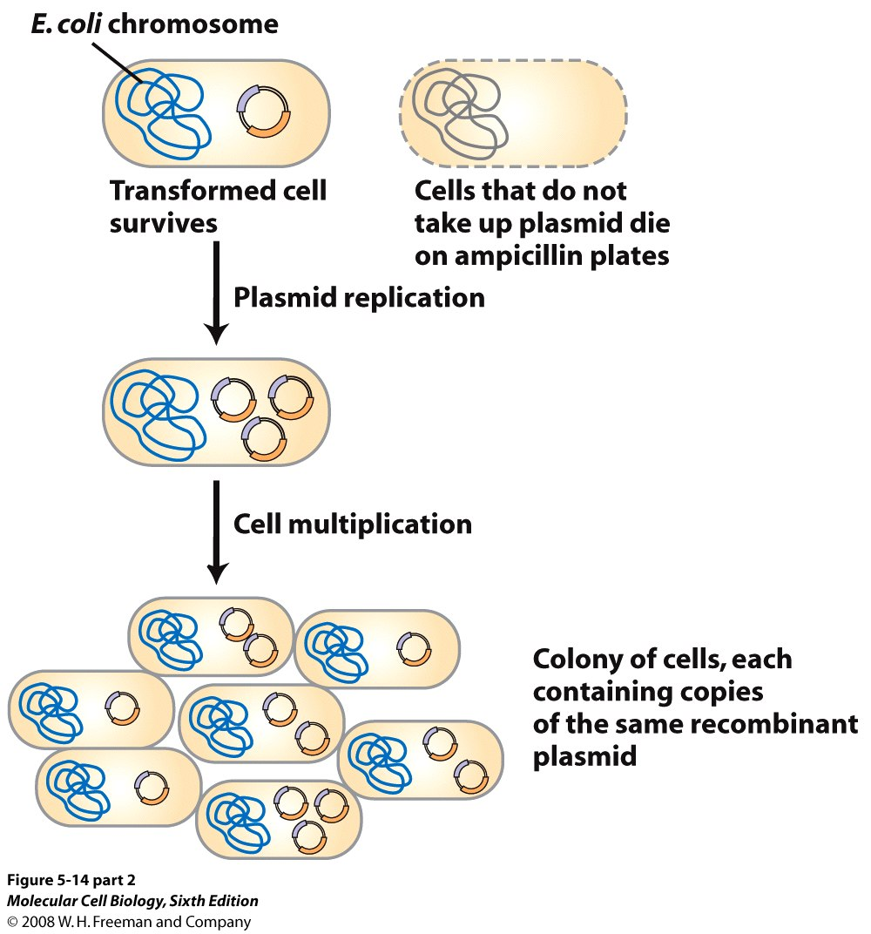
Cloning and Transformation of a Gene

Slide 25
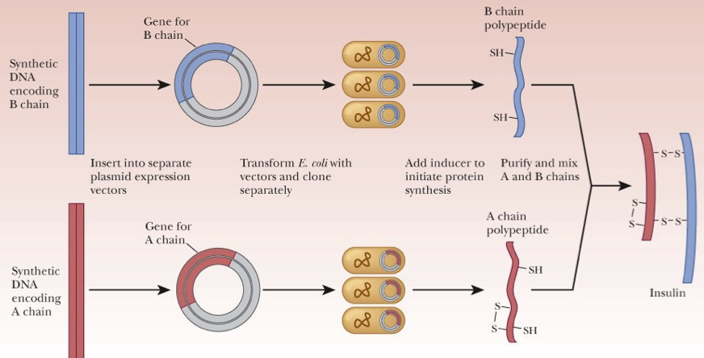
Production of Insulin through Genetic Engineering Approach

Slide 26
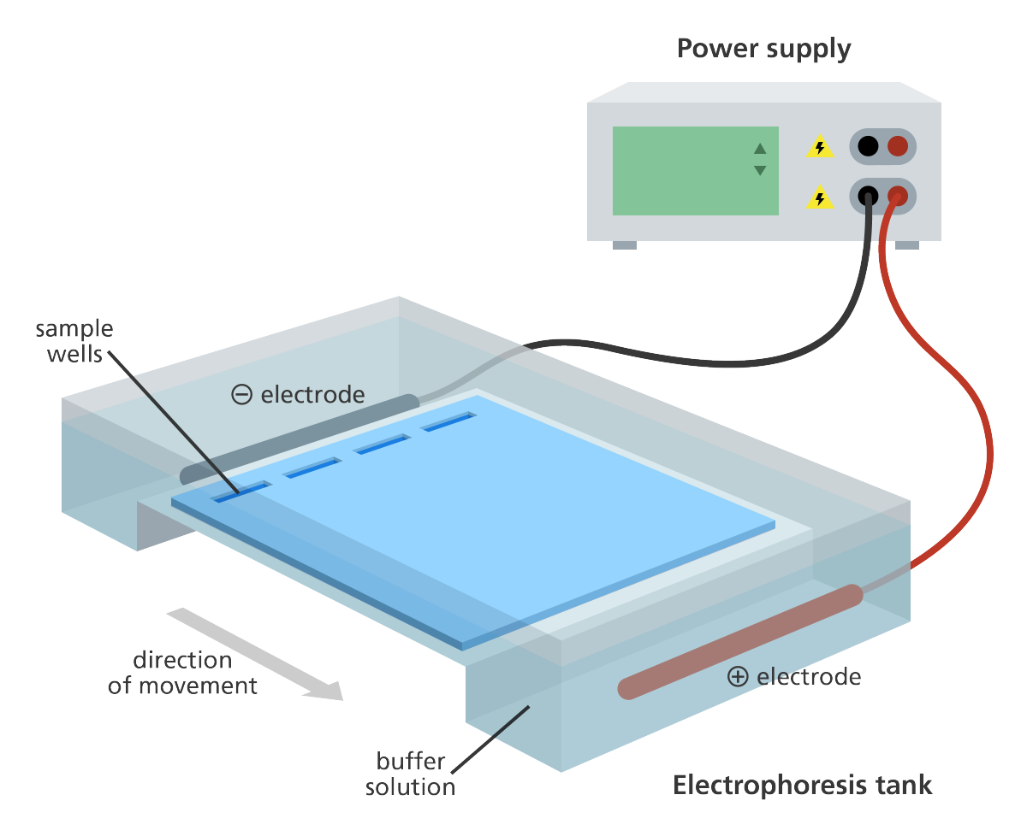
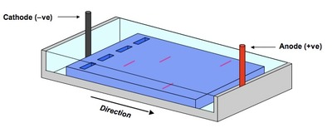
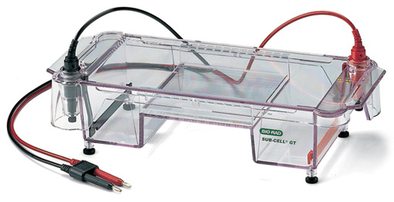
DNA Gel Electrophoresis

Slide 27
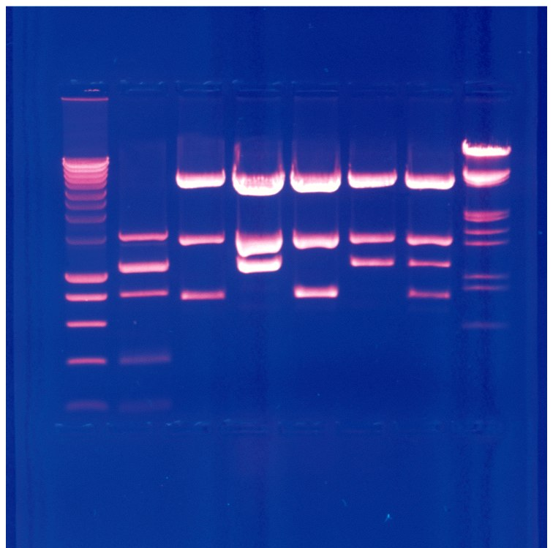
DNA Gel Electrophoresis
Agarose gel is used to analyze a mixture of DNA.
DNA is negatively charged and hence migrates towards the positive terminal in the applied electric field gradient.
Different DNA molecules separate according to mass.
Smaller molecules migrate faster.
DNA is visualized in the gel by staining with ethidium bromide, which fluoresces under UV light.
UV light at 302 nm or 365 nm wavelengths used.

Slide 28
Cloning Whole Animals
Two techniques
- Embryo splitting
- Nuclear transfer

Slide 29
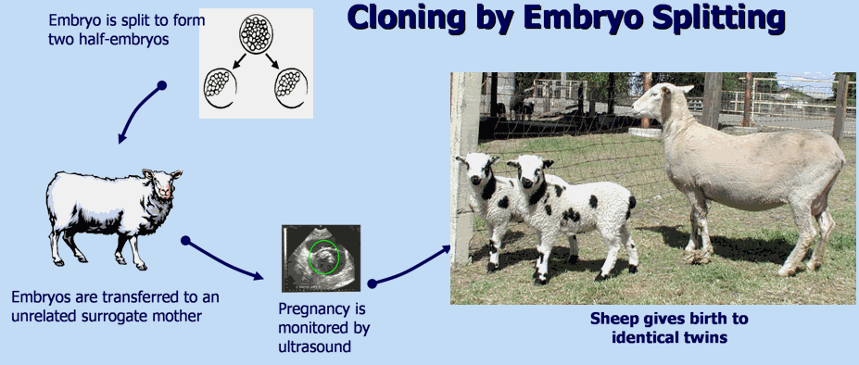
Embryo Splitting
Egg collected
Fertilized by in vitro fertilization (IVF)
Embryo is grown to 8–16 cells
Cells are separated
Separated cells grown into separate embryos
Embryos transplanted into surrogate mothers

Slide 30
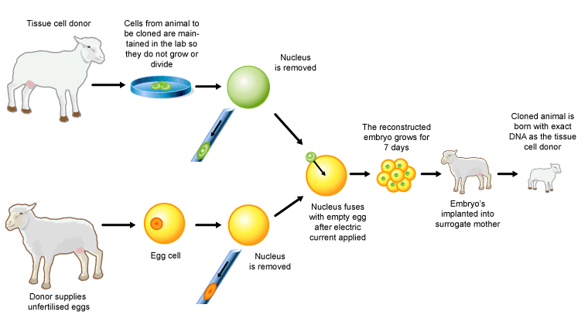
Nuclear Transfer

Slide 31
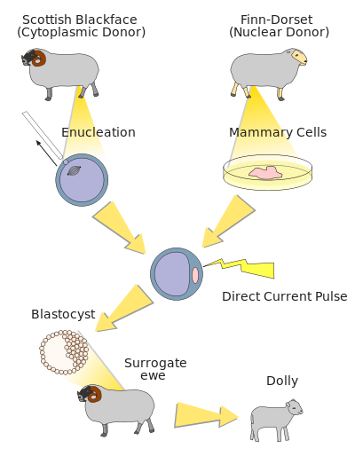
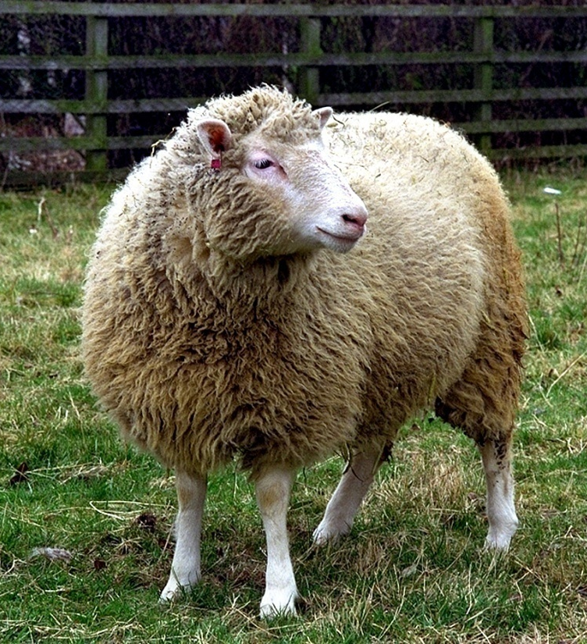
The First Cloned Mammal
Born on 5th July, 1996 at Roslin Institute, Edinburgh, Scotland

Slide 32
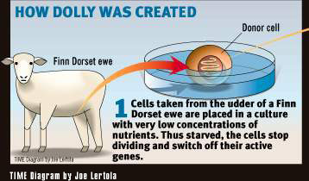
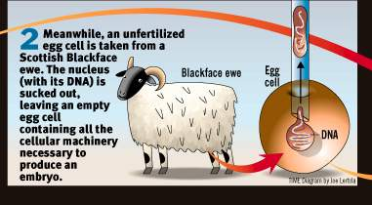
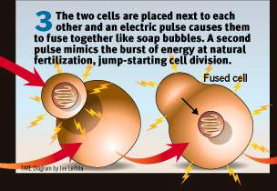
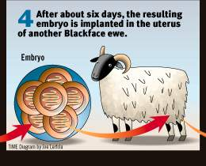
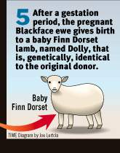
Times 1997

Slide 33
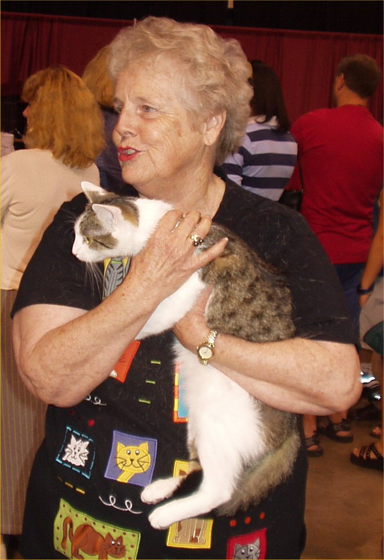
The First Cloned Cat
In 2001, scientists at Texas A&M University created the first cloned cat known as Copy Cat/Cloned Cat (CC).

Slide 34

Ethical issues of Genetic Engineering:
Selecting Best Possible Features from Parents!
Director: Andrew Niccol
Notes:
In a 1997 review of the film for the journal Nature Genetics, molecular biologist Lee M. Silver stated that "Gattaca is a film that all geneticists should see if for no other reason than to understand the perception of our trade held by so many of the public-at-large".

Slide 35

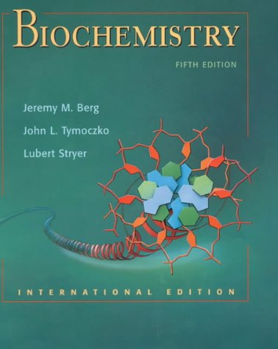
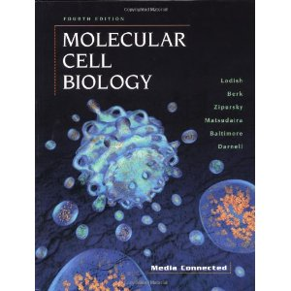
REFERENCES
Stryer…
Baltimore, Lodish..

